Slide 1
Building a stock assessment package: the developments towards CASAL² Presentation to ICES ASC 2015, A:13
Ian Doonan
Alistair Dunn
Kath Large

Slide 2
CASAL: a summary
C++ algorithmic stock assessment laboratory
Generalised software that implements a fairly standard age- (or length-) structured discrete time-step population dynamics model
Bayesian analyses available
Multiple fleets and fisheries occurring in single or multiple areas
First available in 2001
Extensively used within New Zealand
used to assess most toothfish stocks at CCAMLR
At end of development life, hard to maintain, difficult to extend and improve
Notes:
See SS3 & other similar programs
Modern methods
More scope in range of problems
Easily extended

Slide 3
Building a new assessment model - CASAL²
Replaces CASAL
More flexibility
Modern methods
assessment methods
programming
High maintainability & easily extended
Notes:
See SS3 & other similar programs

Slide 4
CASAL has changed the way we work Shift focus & effort → time efficiency ≡ costs
CASAL-1
Scientific
investigation
Model
development
Model development
Scientific
investigation
Notes:
I’ve hgh lighted one aspect of how CASAL has changed the way in which we work.
Before this tool, models were often one off, written by a single person for a single problem
With CASAL, we now spend less time on code development, bug and error checking, and simply “turning the handle”
More time is focused on the validity of models, how well they fit out assumptions, and how we can interpret the output.
Plus, as the tool is becoming recognised by Ministry of Fisheries and Industry, we find they want to spend more time in collaboration, rather than competition.

Slide 5
CASAL usage
CASAL-1
Has been valuable for removing conflict, building trust over perceived “good” or “bad” methods or code
Assists scientists
Standard, validated code base with a common knowledge pool of problems and solutions
Standardised interface that ‘self-documents’ each model
Allows a wider pool of staff to be involved
Assists stakeholders
→these functions still important to NIWA
Notes:
Allows a wider pool of staff to draw on
Knowledgeable biologist can concentrate on the assessment rather than knowing all the little mathematical details
Consistent results
Allows more efficient use of time
Assisting stakeholders
Standardised terminology
Standardised mathematical description contained in one place
Consistent outputs allowing easy comparison between models, over time, and across stocks

Slide 6
Problems with CASAL
CASAL-1
Some problems do not fit the model paradigm
hardwired processes
Observation rich and “large” partition models can be unwieldy and too slow to be useful
Cannot be used for:
as operating model – simulation model experiment
to use as an MSE tool
Doesn’t interface easily with other software

Slide 7
Introducing CASAL²
CASAL²
Overcomes problems that CASAL has
Multiple species (incl. predator/prey) , multiple stock, multiple fisheries, multiple areas, sexes, etc
Avoid a structure that prevents solving future unseen problems
generalised processes rather than hard-wired processes
User defined problems
Interpretation is user defined
trade off: slightly more complex syntax with flexibility in problem solving

Slide 8
Development is underway
CASAL²
Open source architecture
Uses a professional developer
Systems design issues defined and (mostly) resolved
Self documentation (code) implemented
Unit test framework and automagic build system fully functional
Statements in code are harvested for manual → manual should stay up-to-date
Detail testing in progress
Metrics:
570 files,
over 90 directories,
30000 lines of C++ code of which 6000 lines of unit tests and 117 test cases (scenarios) in the unit tests, including a number of full models tests to the level of model minimisation
15000 lines of comments

Slide 9
Generalised processes
CASAL²
Input commands are generalisations rather then hard-wired
E.g., using the command, categories, sex is specified as
but CASAL² does not know about sex explicitly; it is just another user defined category
relationship to stock dynamics is defined by processes that act on the categories not the name
you could have
For one sex models, no categories about sex would be specified
Input files are a bit more verbose, but the syntax allows much more flexibility
We intend to use templates to simplify standard models
@categories
sex male female
@categories
sex male female unsexed

Slide 10
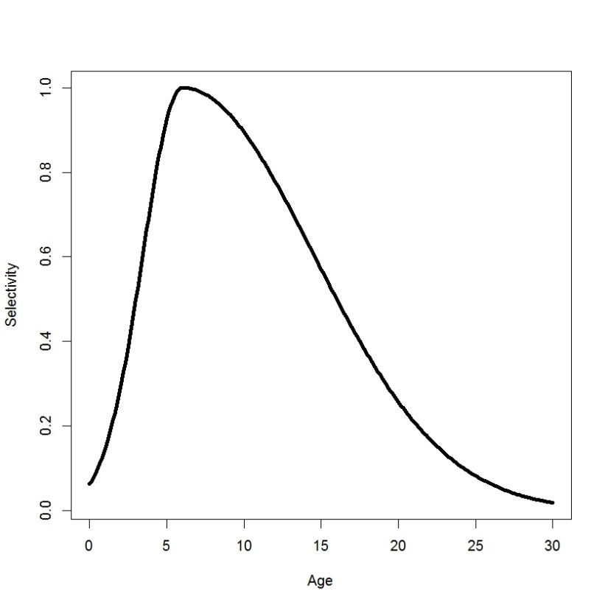
Example inputs
## Fishing Mortality
@process fisheries
type mortality_instantaneous
m 0.19
table catches
! include Hake_catches.txt
end_table
table fisheries
fishery category selectivity step
FishingWest stock westFSel s_1
FishingEest stock eastFSel s_1
end_table
CASAL²
## Fishing Mortality
@process fisheries
type mortality_instantaneous
m 0.19
table catches
year FishingWest FishingEast
1975 80 111
1976 152 336
…
2012 80 152
end_table
table fisheries
fishery category selectivity step
FishingWest stock westFSel s_1
FishingEest stock eastFSel s_1
end_table
@selectivity westFSel
type double_normal
mu 6
sigma_l 3
sigma_r 10
alpha 1.0

Slide 11
Constraints
CASAL²
Must replicate all important current CASAL assessments
Must be self-validating and include modern code design elements
Self contained 3rd party code and build environment
Integrated unit tests and build validation tests
Simple end-user methods for validating model outputs
It should be easy to find errors in input files (e.g., line numbers and file name)
Usable in Management Strategy Evaluations/ simulation studies
Allows for different type of use
“plays nice” with python/R or other software
single step

Slide 12
Next steps
CASAL²
Open source code to be made available to everyone by December 2015
Implement required extra functionality
“Verify” process and template definitions
easier fishery-like commands that hide base commands
R/python code integration
Ongoing: end-user documentation developed
Primer, manual, examples, R library, test suite for validations
Partially done: CASAL model validation and comparison. Update R library to provide plots/tabulate (already extracts results)
Excel interface ?

Slide 13
Acknowledgements
CASAL² development and applications have been funded by NIWA and Ministry for Primary Industries
Scott Rasmussen
The CASAL² development team
Current CASAL-1 version is v2.30-2013-07-30 23:19:18 UTC (rev.4982)
Bull, B.; Francis, R.I.C.C.; Dunn, A.; McKenzie, A.; Gilbert, D.J.; Smith, M.H.; Bian, R.; Fu, D. (2012). CASAL (C++ algorithmic stock assessment laboratory): CASAL user manual v2.30-2012/03/21. NIWA Technical Report. 135. 280 p.

